Slide 1
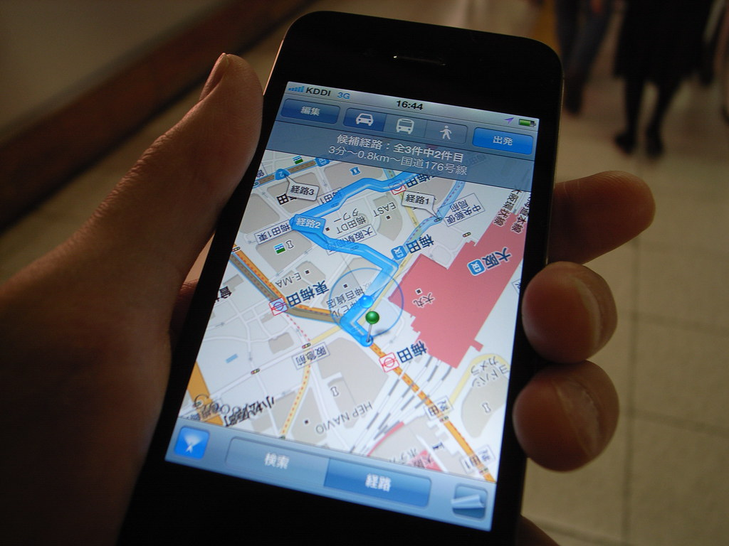
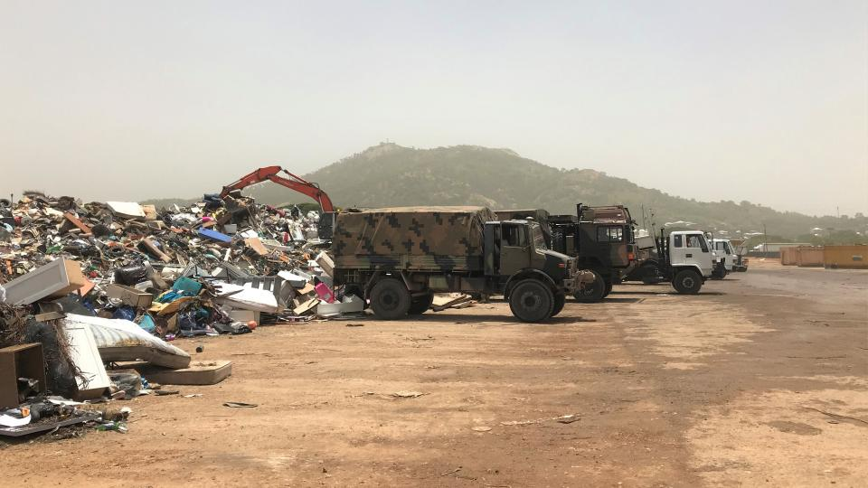



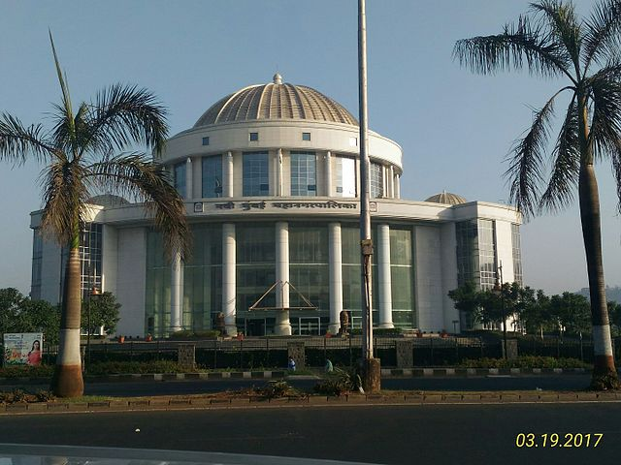

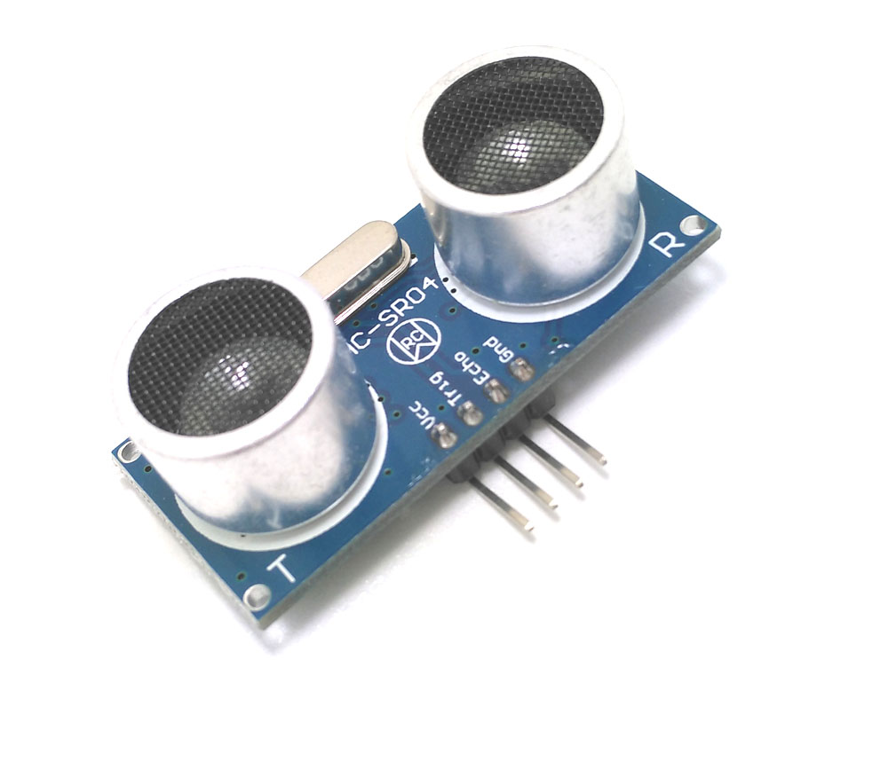
GPS Module
Arduino Uno
GSM Module
Navigation System
City Dump Management
Garbage Collection Trucks
Garbage
Central Cloud Server
Ultrasonic sensor
Municipal Corporation

